Slide 1

Rationale
Introduction to Windows Store App Development Using HTML5 and JavaScript
Computer science is a field of study that deals with solving a variety of problems by using computers.
  To solve a given problem by using computers, you need to design an algorithm for it.
Multiple algorithms can be designed to solve a particular problem.
An algorithm that provides the maximum efficiency should be used for solving the problem.
  The efficiency of an algorithm can be improved by using an appropriate data structure.
Data structures help in creating programs that are simple, reusable, and easy to maintain.
This module will enable a learner to select and implement an appropriate data structure and algorithm to solve a given programming problem.

Slide 2
Objectives
  In this session, you will learn to:
  Use additional UI elements
  Use custom controls
Notes:
2

Slide 3
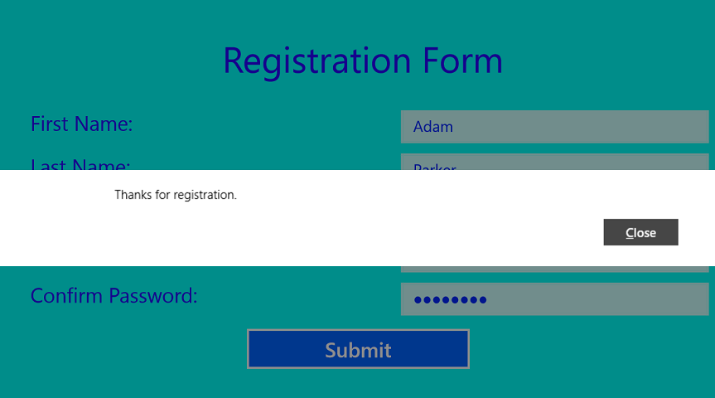


Using Message Dialog
  The MessageDialog control:
  Allows you to display a short message to the user.
  Is displayed in the form of a rectangular container that holds:
    Title
    Message
    A maximum of three commands
  The following figure shows a message dialog.

Slide 4
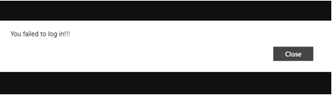
Using Message Dialog (Contd.)
  Displaying a message dialog:
  By using the following code snippet:
      var msg = new Windows.UI.Popups.MessageDialog("You failed to log in!!!");
      msg.showAsync();
  Output:

Slide 5
Using Message Dialog (Contd.)
  Adding a title to a message dialog:
  By using the overloaded constructor of the MessageDialog class, which:
    Displays a title over the message in a message dialog.
    Accepts two string parameters:
Message
Title
First parameter
Second parameter

Slide 6
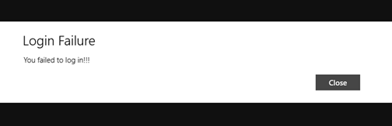
Using Message Dialog (Contd.)
  The following code snippet creates a message dialog with a title:
      var msg = new Windows.UI.Popups.MessageDialog("You failed to log in!!!", "Login Failure");
      msg.showAsync();
  Output:

Slide 7
Using Message Dialog (Contd.)
  Adding buttons to a message dialog:
  By using the commands.append() function, which has two parameters:
Label of the command button
Associated event handler
First Parameter
Second Parameter

Slide 8
Using Message Dialog (Contd.)
Let us look at an example, which adds buttons to a message dialog

Slide 9
Just a Minute
  Which one of the following controls allows you to add a short description to another control?
    1. Popup menu
    2. Tooltip
    3. Menu
    4. Message dialog

Slide 10
Just a Minute (Contd.)
  Solution:
    2. Tooltip

Slide 11
Using Custom Controls
  You can create your own customized controls for your app for:
Designing specific appearance
Implementing desired functionality
Defining desired control capabilities
Notes:
11

Slide 12
Creating a Custom Control
  Similar to a predefined control, a custom control will also have its properties, methods, and events.
  To create a custom control:
Define a namespace for the control.
Define the control constructor within the namespace.
Define the methods and properties for the control.
Define custom events and event details for the control.

Slide 13
Creating a Custom Control (Contd.)
Let us look at an example, which creates a custom control

Slide 14
Just a Minute
  The second parameter of the WinJS.Class.define() function takes an object containing the ____________ methods and properties of the control.
    1. Static
    2. Public
    3. Constant

Slide 15
Just a Minute (Contd.)
  Solution:
    2. Public

Slide 16
Adding a Custom Control to an App
  A custom control can be added to an app by using the <div> element and setting its data-win-control property to the name of the custom control.
  The following code snippet adds the survey custom control:
    <div id="surveyDiv"
    data-win-control
    ="ControlStore.surveyControl"></div>
    <div id="responseDiv"></div>
  To record the response, you need to define the event handler for the select event of the preceding custom control.

Slide 17



Adding a Custom Control to an App (Contd.)
  Output:
  When you select Yes, the corresponding response message is displayed, as shown in the following figure.
  When you select No, the difference response message is displayed, as shown in the following figure.

Slide 18
Summary
  In this session, you learned that:
  The MessageDialog control allows you to display a short message to the user.
  A custom control is the same as any predefined control.
  Similar to a predefined control, a custom control will also have its properties, methods, and events.
Notes:
18

Slide 19

Q&A

